Slide 1
Semantic Edge Detection
Levon Khachatryan
https://github.com/lev1khachatryan/SemanticEdgeDetection

Slide 2
1.
Choose a video from the DAVIS dataset, get frames, obtain the edges of the frames from the annotations of these frames.

Slide 3

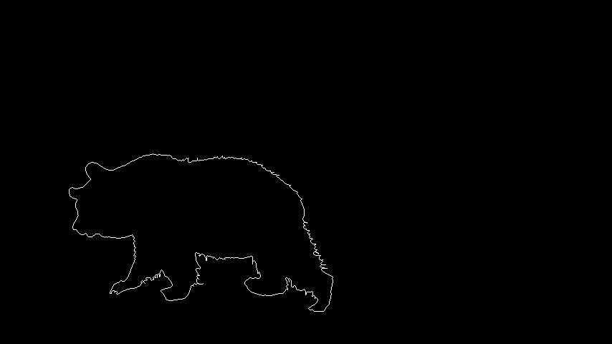
End Result

Slide 4



Using erosion morphological operation
mask – erode(mask)

Slide 5
2.
Build an Encoder-Decoder architecture to train a neural network for semantic edge detection on a single image. Take as encoder one of the ResNet (18, 50 or 101) architectures and initialize it with a pre-trained model.

Slide 6
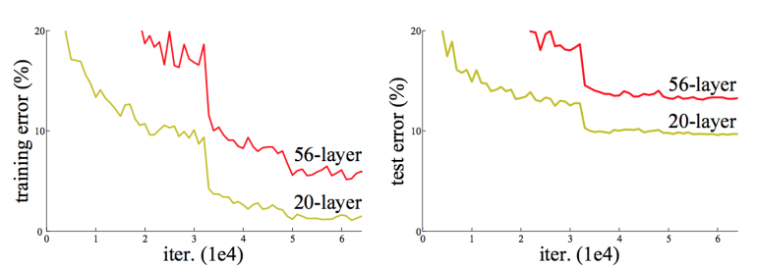
ResNet (degradation problem)

Slide 7
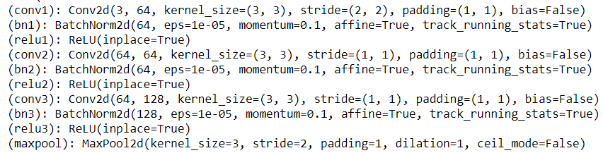
ResNet (first block)
'https://s3.amazonaws.com/pytorch/models/resnet50-19c8e357.pth’
'http://mit.edu/model/pretrained_resnet/resnet50-imagenet.pth'

Slide 8
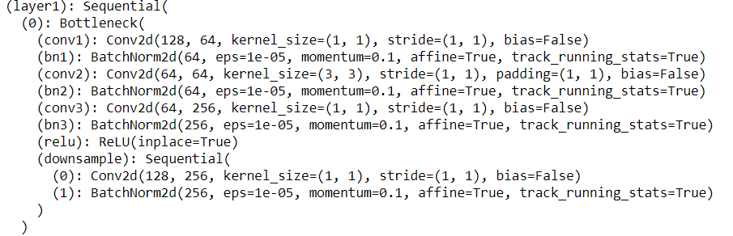
ResNet (bottlenecks 3-4-6-3)

Slide 9
ResNet (more details)
Input
[BS, 3, 450, 450]
4 layers outputs
[BS, 256, 113, 113]
[BS, 512, 57, 57]
[BS, 1024, 29, 29]
[BS, 2048, 15, 15]

Slide 10
UPerNet (Decoder)
It is a model based on Feature Pyramid Network (FPN) and Pyramid Pooling Module (PPM). It doesn't need dilated convolution, an operator that is time-and-memory consuming.

Slide 11
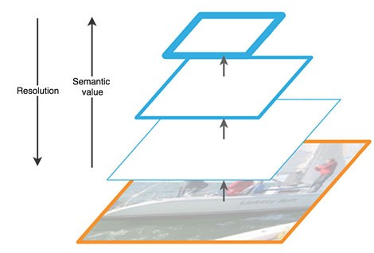
Feature Pyramid Network (FPN)
As we go up, the spatial resolution decreases. With more high-level structures detected, the semantic value for each layer increases.

Slide 12
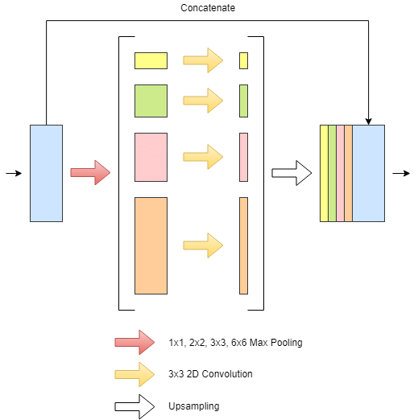
Pyramid Pooling Module (PPM)
As we go up, the spatial resolution decreases. With more high-level structures detected, the semantic value for each layer increases.

Slide 13
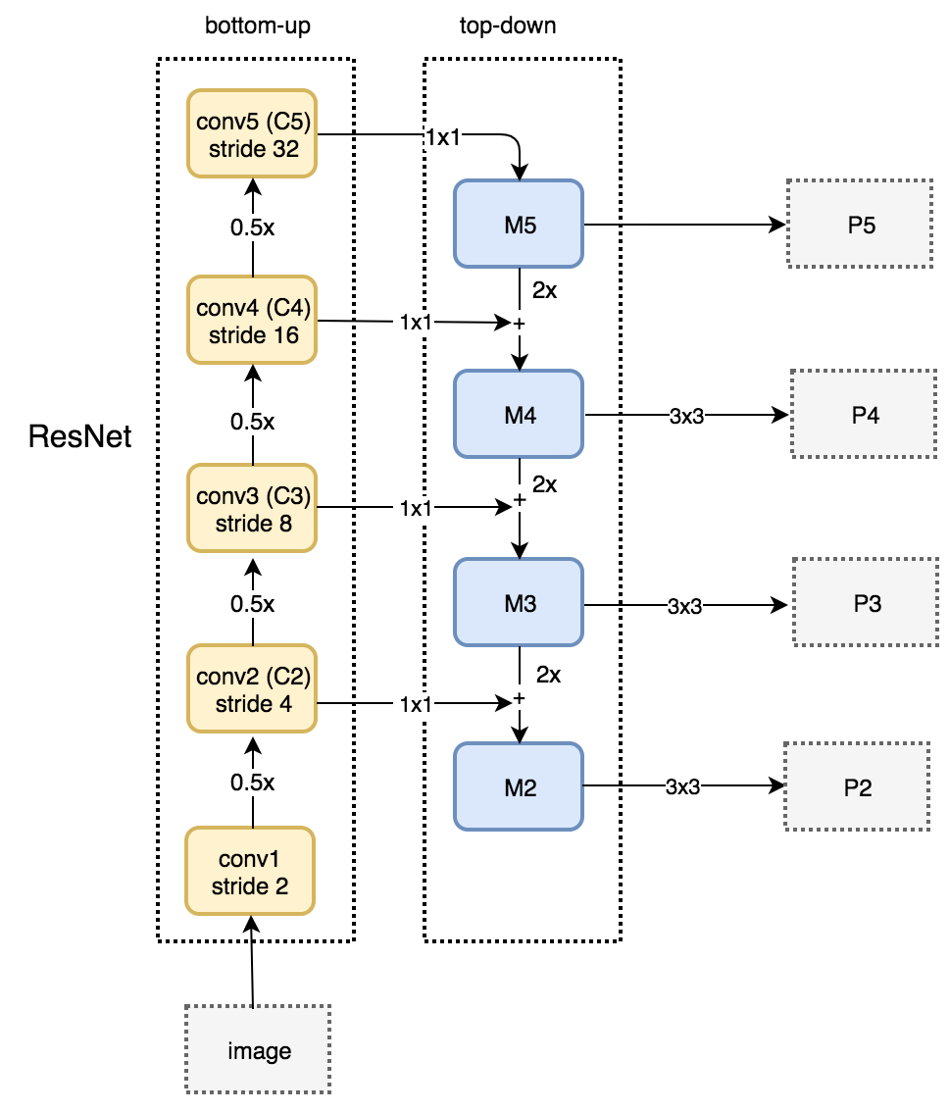
We apply a 1 × 1 convolution filter to reduce C5 channel depth to 256-d to create M5.
As we go down the top-down path, we up sample the previous layer by 2 using nearest neighbors up sampling. We again apply a 1 × 1 convolution to the corresponding feature maps in the bottom-up pathway. Then we add them element-wise. We apply a 3 × 3 convolution to all merged layers.

Slide 14
UPerNet (more details)
P5 = Conv3x3(Concat(Conv1x1(Itpl(Pool1(C5))), …)) 256 dim
…
Sigmoid(Conv1x1(Concat(Itpl(Pi))))
[BS, 2, 450, 450]

Slide 15
3.
Define a loss function, overfit the model on the chosen video’s frames.

Slide 16
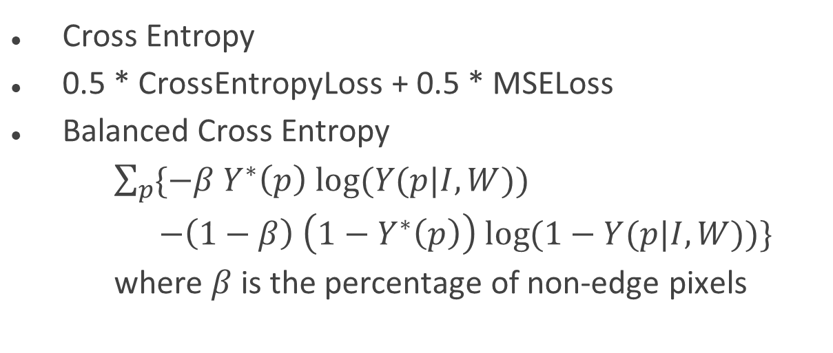
Loss function
Cross Entropy
0.5 * CrossEntropyLoss + 0.5 * MSELoss
Balanced Cross Entropy
$\sum_{p}^{ }{\{−β Y^{∗}\left(p\right) log⁡(Y(p|I,W))}$
$$−\left(1−β\right) \left(1−Y^{∗}\left(p\right)\right) log⁡(1−Y(p|I,W))\}$$
where $β$ is the percentage of non-edge pixels

Slide 17
Evaluation Metrices
Pixel accuracy
Dice Coefficient (F1 Score)

Slide 18
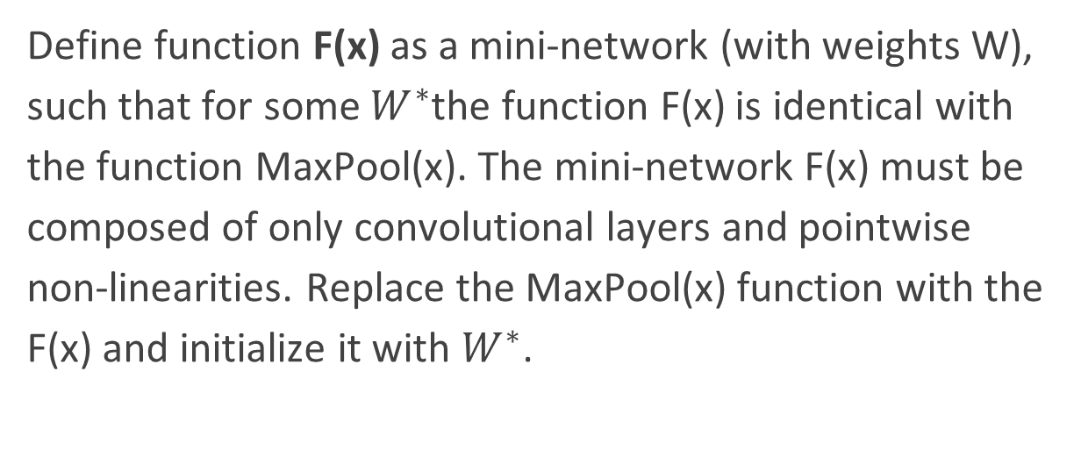
4.
Define function F(x) as a mini-network (with weights W), such that for some $W^{∗}$the function F(x) is identical with the function MaxPool(x). The mini-network F(x) must be composed of only convolutional layers and pointwise non-linearities. Replace the MaxPool(x) function with the F(x) and initialize it with $W^{∗}$.

Slide 19
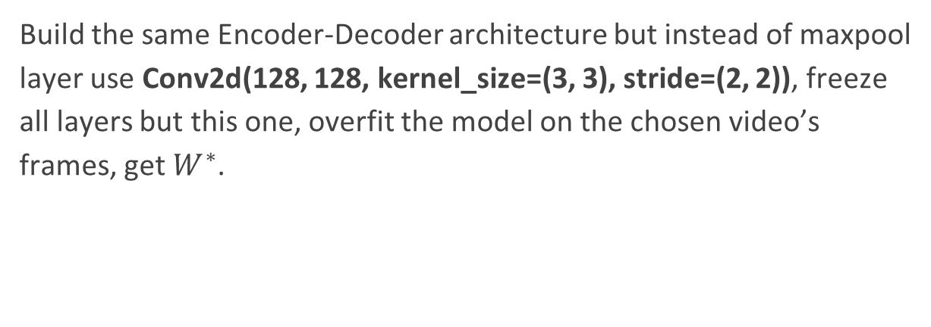
Pooling vs Strided Convolution
Build the same Encoder-Decoder architecture but instead of maxpool layer use Conv2d(128, 128, kernel_size=(3, 3), stride=(2, 2)), freeze all layers but this one, overfit the model on the chosen video’s frames, get $W^{∗}$.

Slide 20
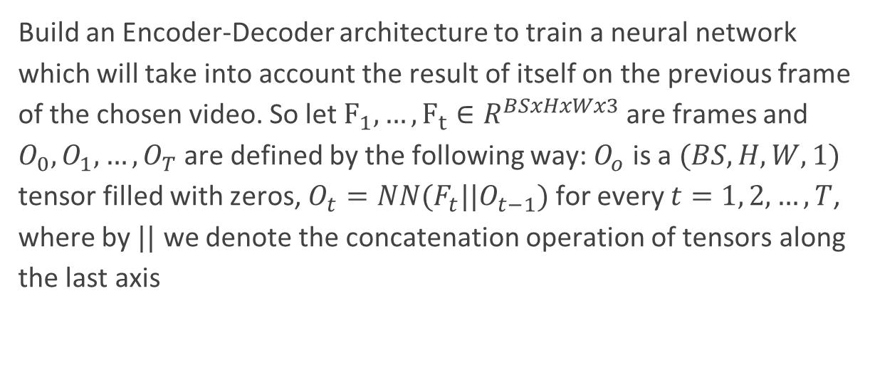
5.
Build an Encoder-Decoder architecture to train a neural network which will take into account the result of itself on the previous frame of the chosen video. So let $F_{1},…, F_{t}∈R^{BSxHxWx3}$ are frames and $O_{0},O_{1},…, O_{T}$ are defined by the following way: $O_{o}$ is a $(BS, H, W, 1)$ tensor filled with zeros, $O_{t}=NN(F_{t}||O_{t−1})$ for every $t=1, 2, …, T$, where by $||$ we denote the concatenation operation of tensors along the last axis

Slide 21
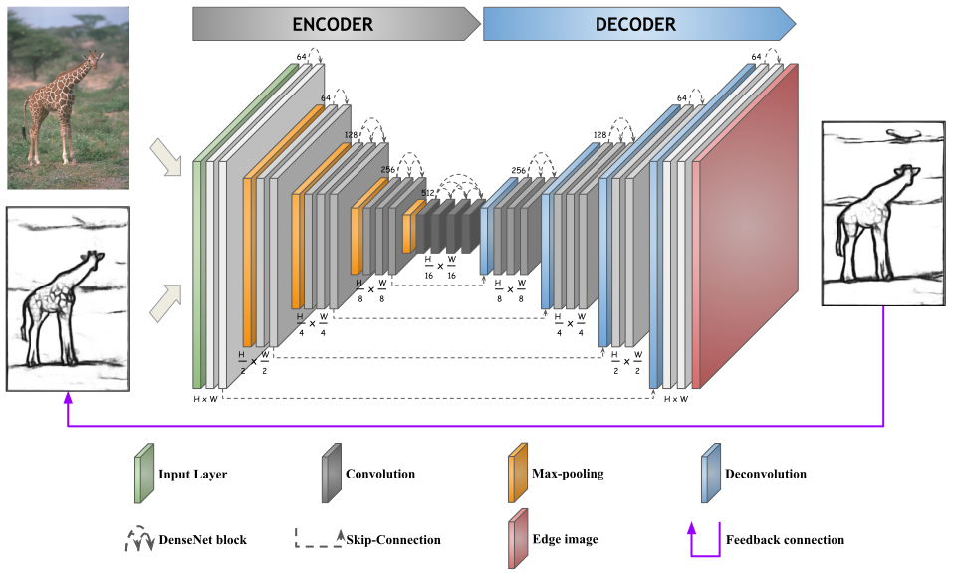
Recursive Encoder–Decoder with Skip-Connections

Slide 22
8.
Add Perceptual losses to the training

Slide 23
Layers of CNN
Early layers of a CNN return low-level spatial information regarding local relations, such as information about edges. As we proceed towards deeper layers, we start to learn higher level features with more semantic meaning and abstract object information, and less fine-grained spatial details from an image. In this fashion, mid-level features are mostly representing textures and high-level features amount to the global semantic meaning.

Slide 24
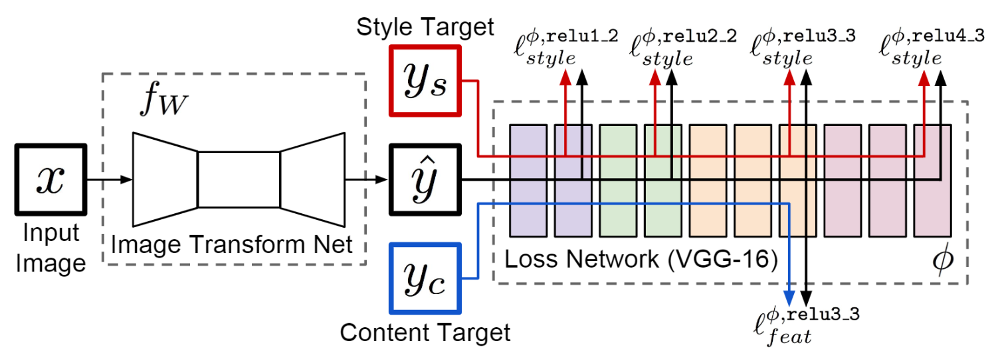
Perceptual Loss

Slide 25

Perceptual Loss
$$l_{feat}^{j}\left(y^{∗}, y\right)=\frac{1}{C_{j}H_{j}W_{j}}{\left|\left|φ_{j}\left(y^{∗}\right)−φ_{j}\left(y\right)\right|\right|}_{2}^{2}$$

Slide 26
9.
Add non-maximum suppression after the output of the network. The
non-maximum suppression must be a part of the main graph and not just a post-processing function (to be able to put loss after the non-maximum suppression operation and train network with this op.).

Slide 27
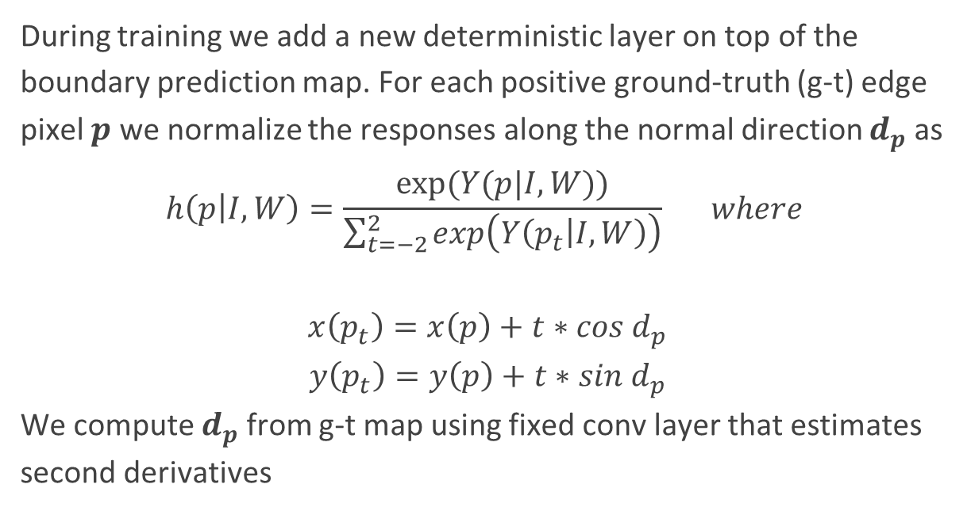
During training we add a new deterministic layer on top of the boundary prediction map. For each positive ground-truth (g-t) edge pixel $p$ we normalize the responses along the normal direction $d_{p}$ as
$$h\left(p | I, W\right)=\frac{exp⁡(Y(p|I, W))}{\sum_{t=−2}^{2}{exp\left(Y\left(p_{t} | I, W\right)\right)}} where$$
$$x\left(p_{t}\right)=x\left(p\right)+t∗cos{ d}_{p}$$
$$y\left(p_{t}\right)=y\left(p\right)+t∗sin{ d}_{p}$$
We compute $d_{p}$ from g-t map using fixed conv layer that estimates second derivatives

Slide 28

$$L_{nms}\left(W\right)=\sum_{p}^{.}{log⁡} h\left(p\right|I, W)$$
p indexes only boundary pixels.

Slide 29
THANK YOU !

